Slide 1
Smart Doorlock
Sokwhan Huh
Fall 16

Slide 2
Smart Doorlock
0. Contents
Overview
Project Specifications / Requirements
Technology Background
Design (Hardware & Software)
Operation Modes
Demo
Cost Analysis
Results

Slide 3
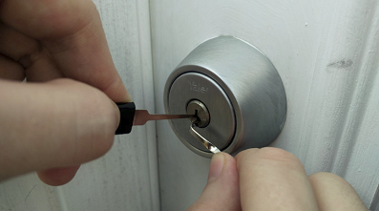
Smart Doorlock
1. Overview
Traditional door locks are…
Insecure & Inconvenient!
We need a better lock!

Slide 4
Smart Doorlock
2. Project Requirements
Two ways to operate the door lock
NFC (Smartphone Contact)
IoT (Internet)
Grant / Revoke permissions
Manage access logs

Slide 5
Smart Doorlock
3. Project Specifications
Supported Android versions (NFC): 4.4 (Kitkat) and above
NFC communication range: 5 cm max
Wi-Fi communication range: 50 meters max
AC power with DC battery backup
Minimum backup battery life of 24 hours

Slide 6
Smart Doorlock
4. Technical Specifications
NFC
ISO7816-4 / ISO14443a specification
Android HCE (Host-card based emulation)
IoT
MQTT Protocol
Software / Frameworks
MCU: TI-RTOS, C language
Server Side: NancyFX (WS), MySQL (DB), C# language
Android App: Java

Slide 7
Smart Doorlock
5. Technology (NFC)
NFC (Near Field Communication)
A subset of RFID technology
13.56 Mhz
Close distance
Applications range from commerce, bootstrapping connections, social networking etc.

Slide 8
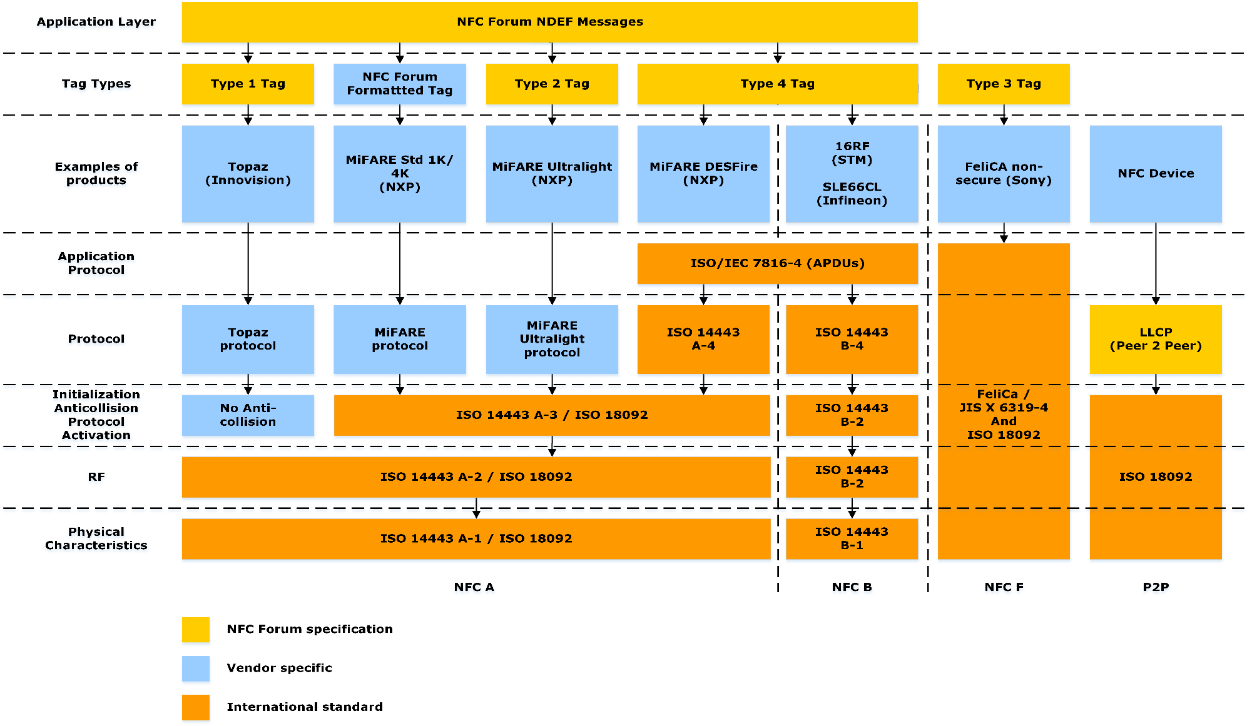
Smart Doorlock
5. Technology (NFC)
Protocol Stack
Source: https://commons.wikimedia.org/wiki/File:NFC_Protocol_Stack.png

Slide 9

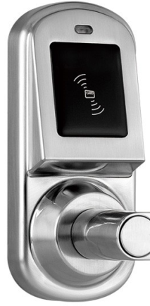
Smart Doorlock
5. Technology (NFC)
Send REQA & SAK (Anticollision)
Protocol Stack & Flow (ISO 14443)
Respond ATQA & UID (Anticollision)
NDEF (NFC Data Exchange Format)
Application Layer
Send RATS & PPS (Transport)
ISO/IEC 14443
ISO 7816-4 APDU, Application Protocol
Respond ATS & PPS (Transport)
ISO 14443-4
Transport Protocol
Select AID (APDU)
ISO 14443-3 Type A
Activation, Anticollision
Android Phone (HCE)
NFC Reader
Respond AID (APDU)
ISO 14443-2 Type A
Power, Bit Transmission
ISO 14443-1 Physical Properties
NDEF Comm. (Application)

Slide 10
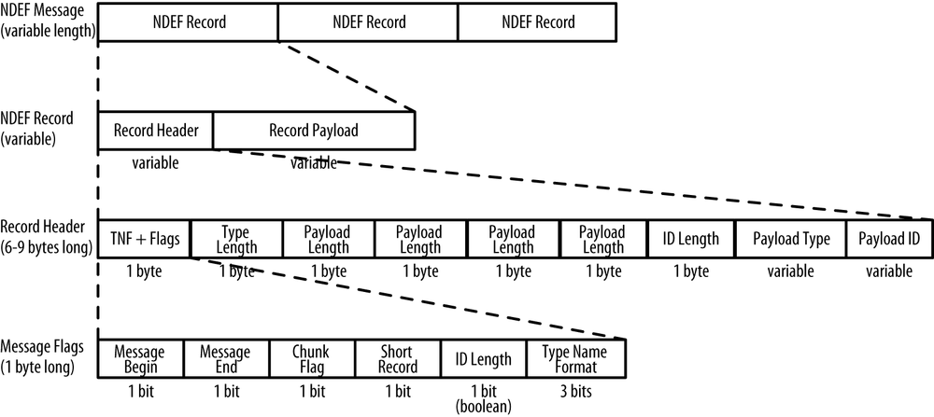
Smart Doorlock
5. Technology (NFC)
NDEF Structure
Source: https://www.safaribooksonline.com/library/view/beginning-nfc/9781449324094/ch04.html

Slide 11
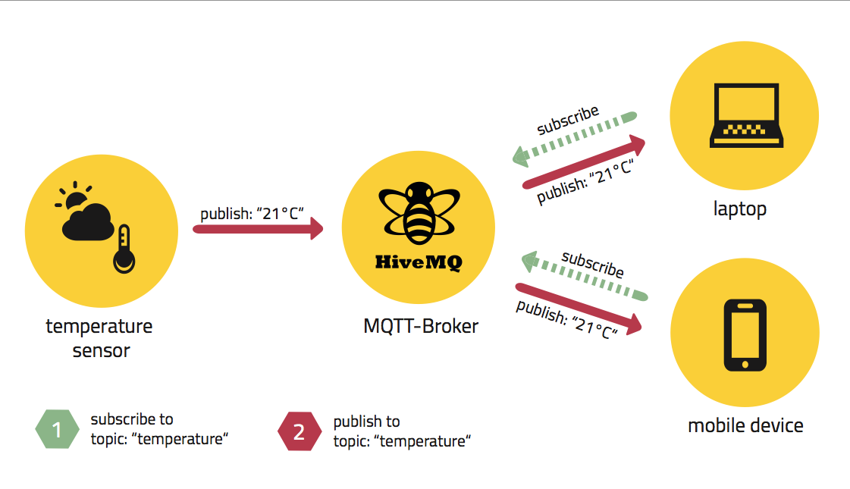
Smart Doorlock
6. Technology (IoT)
MQTT Protocol
A lightweight protocol intended for Internet of Things
Publish / Subscribe based
On top of TCP / IP
Source: http://www.hivemq.com/blog/how-to-get-started-with-mqtt

Slide 12
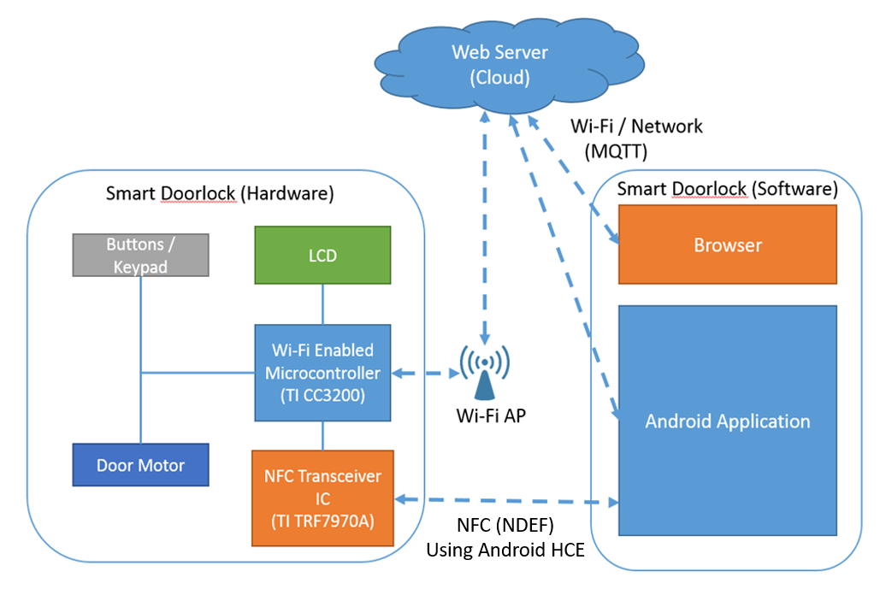
Smart Doorlock
7. Block Diagram

Slide 13
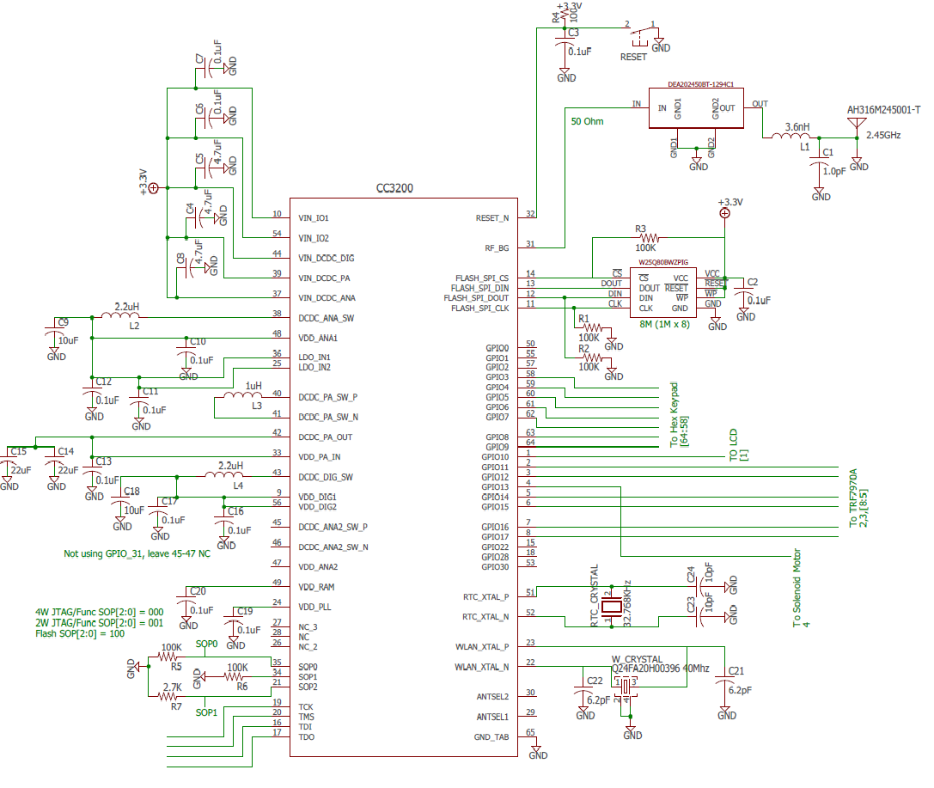
Smart Doorlock
8. Design (Hardware, MCU)

Slide 14
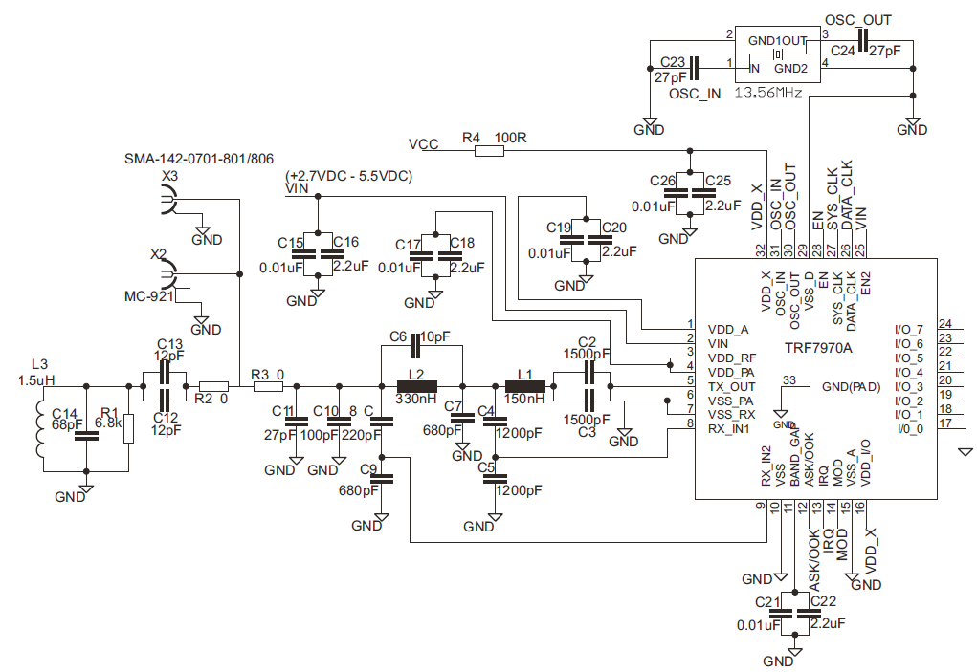
Smart Doorlock
8. Design (Hardware, TRF7970A)

Slide 15
Smart Doorlock
9. Design (Software)
Initialize HW components (MCU, LCD, NFC Reader)
Create /Load Config File
IOT Enabled?
Y
Connect to AP &
MQTT Broker
N
Start IOT Task
NFC
Enabled?
Y
Start Menu Task
Start NFC Task

Slide 16
Smart Doorlock
10. Operation Modes
Active
Allows unlocking the doorlock by NFC / IOT
Configuration
Register / Unregister phone
Set doorlock mode (NFC only, IOT only, NFC & IOT)
Wi-Fi Configuration

Slide 17
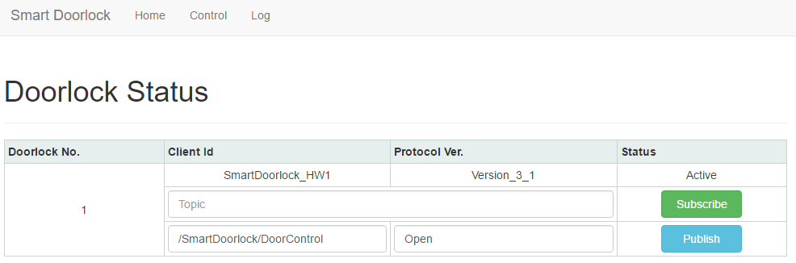
Smart Doorlock
11. Operation – Doorlock Control
To open the doorlock
Tap a registered smartphone to NFC reader
Use internet browser or Android Application

Slide 18
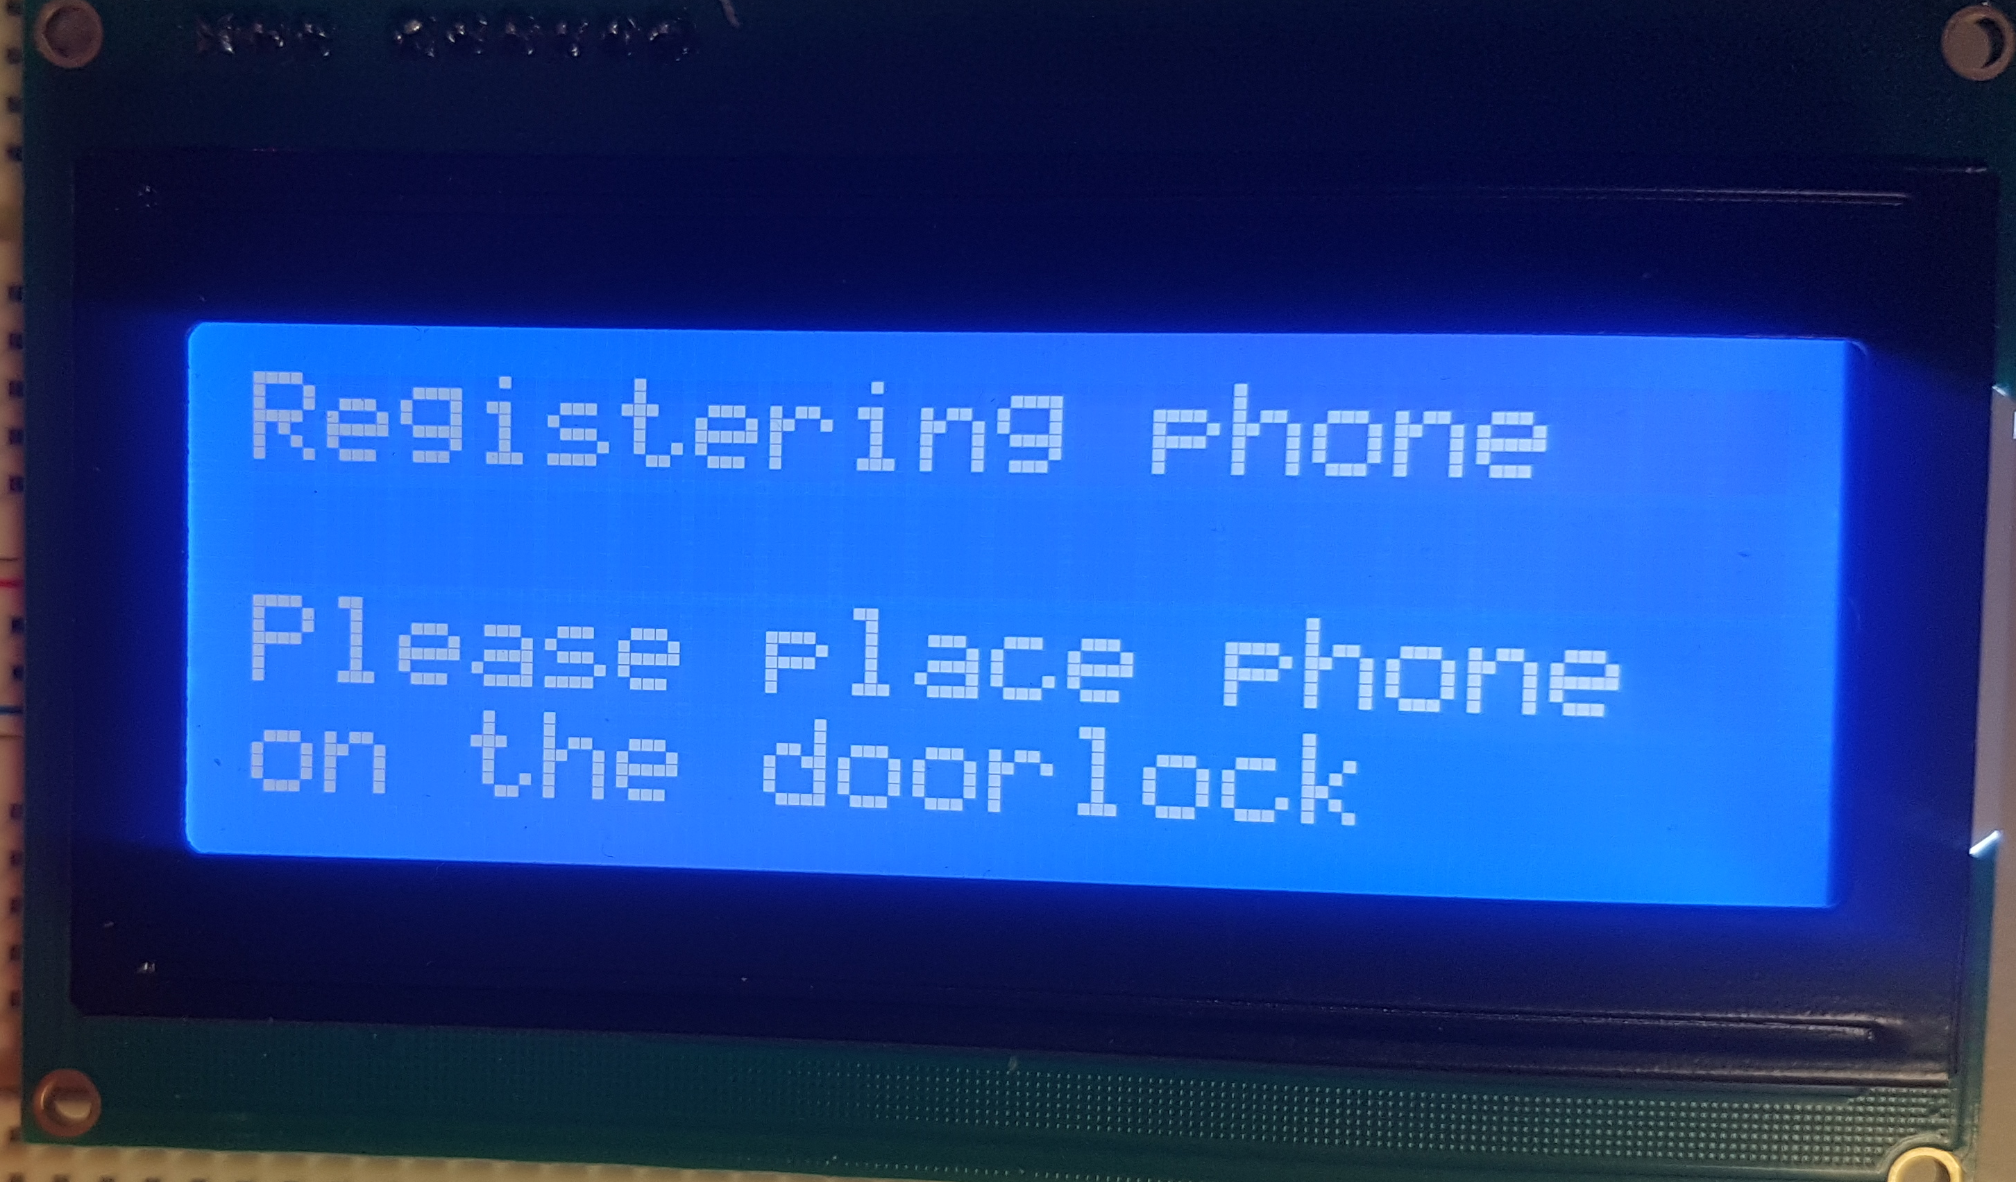
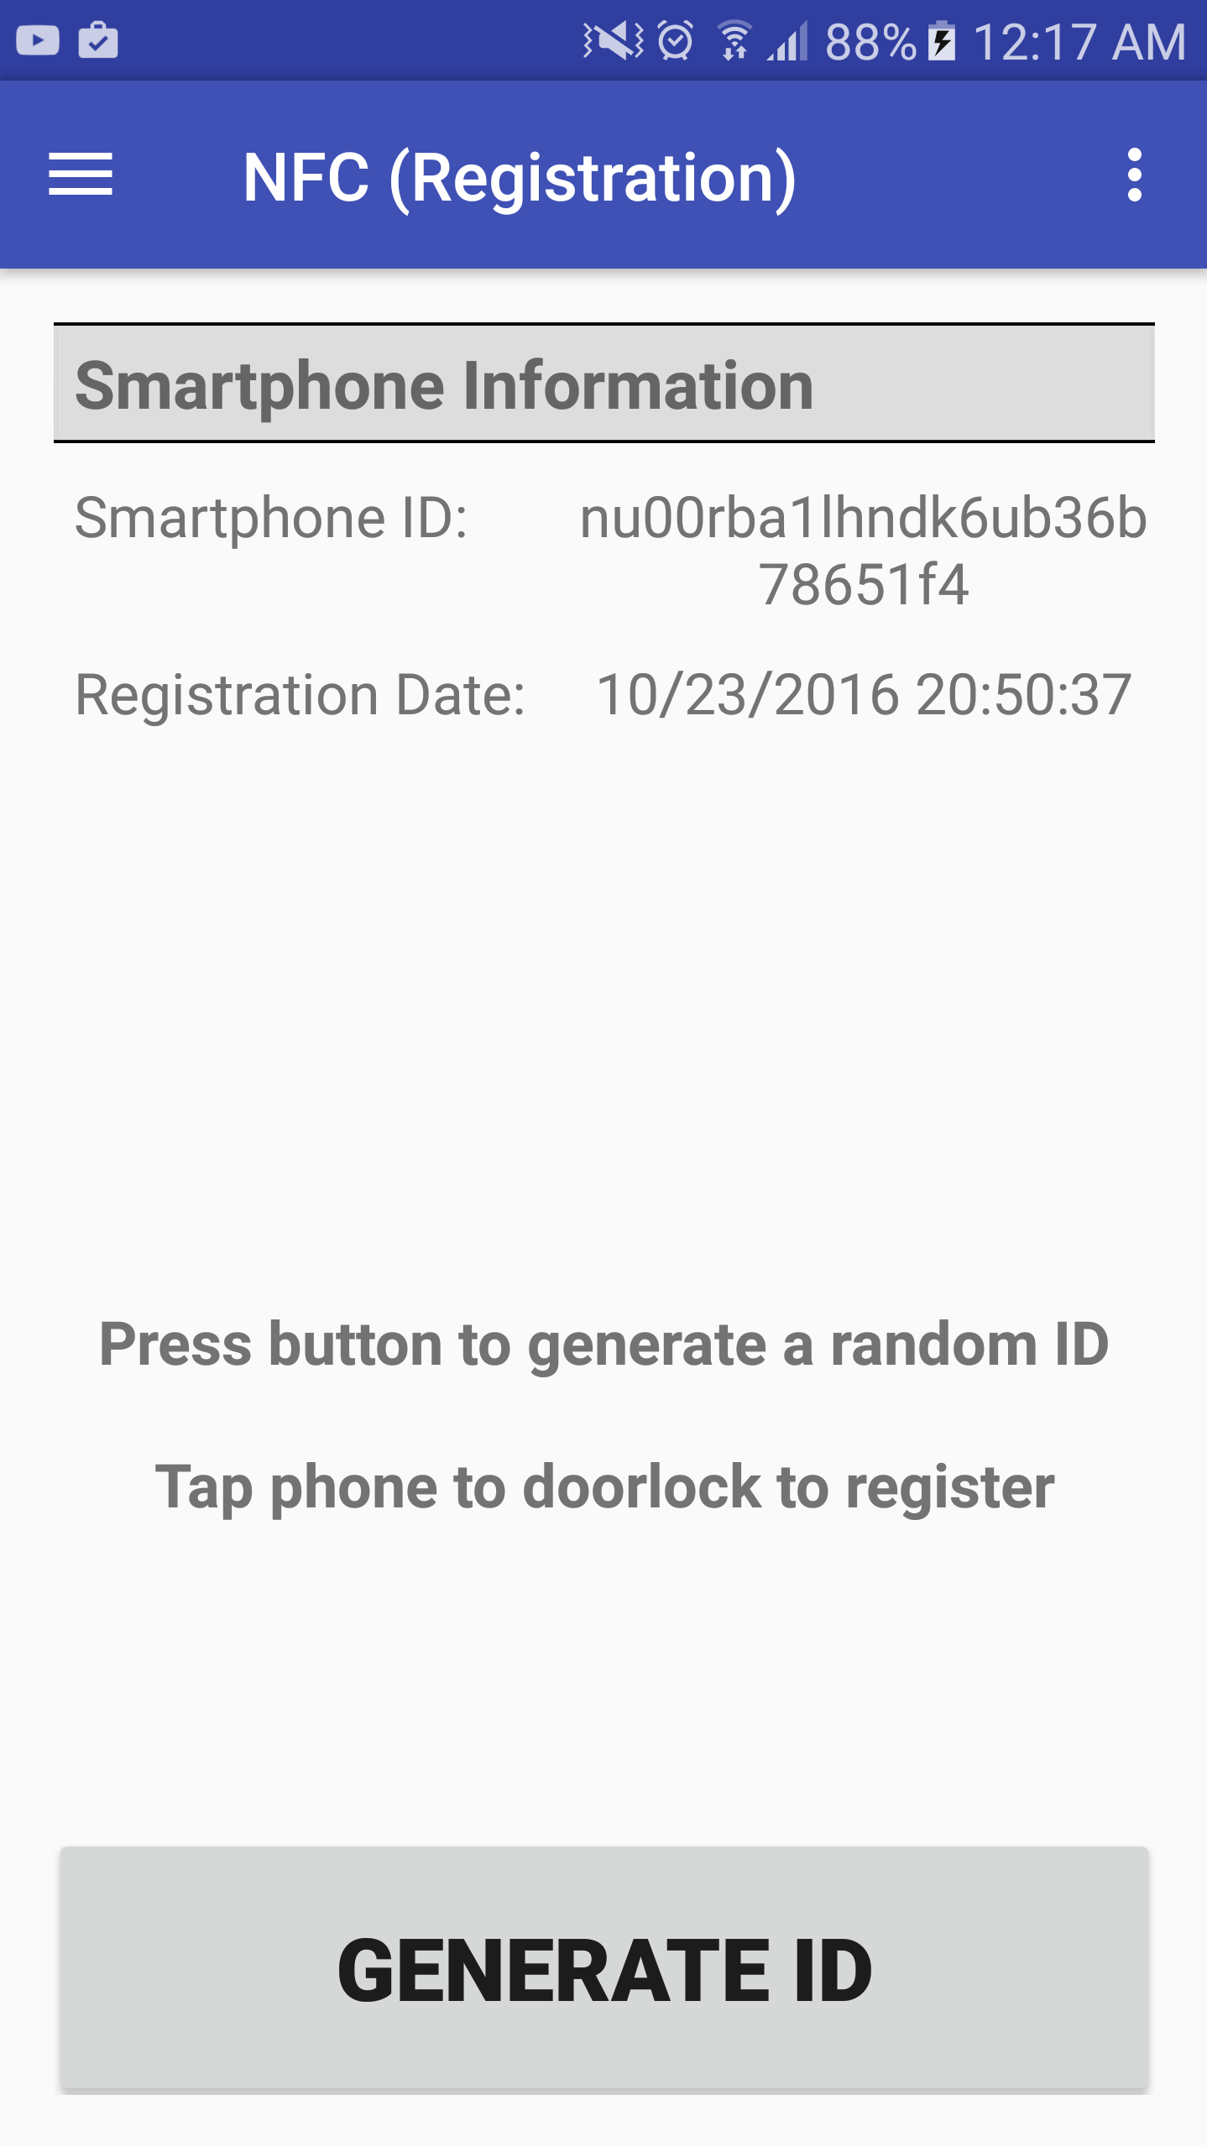
Smart Doorlock
12. Configuration – Phone Registration
Enter registration mode in doorlock
Enter registration mode in Android application
Notes:
https://www.youtube.com/watch?feature=player_detailpage&v=Cytk-GvEdA8#t=59

Slide 19
Smart Doorlock
12. Configuration – Phone Registration
3) Tap phone to NFC reader
REG_PHONE|nu00rba1lhndk6ub36b78651f4
*Encrypted payload is sent
Notes:
https://www.youtube.com/watch?feature=player_detailpage&v=Cytk-GvEdA8#t=59

Slide 20
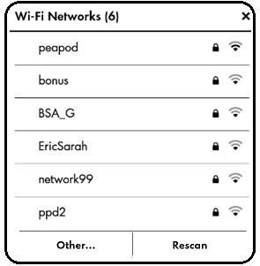
Smart Doorlock
12. Configuration – Wi-Fi
WIFI_CONFIG|SSID|TEST1AP|PASSWORD|PW123|SEC_TYPE|WPA2-PSK(AES)
*Encrypted payload is sent
Notes:
https://www.youtube.com/watch?feature=player_detailpage&v=Cytk-GvEdA8#t=59

Slide 21
Smart Doorlock
14. Demo Videos
NFC & IoT demo videos
Notes:
https://www.youtube.com/watch?feature=player_detailpage&v=Cytk-GvEdA8#t=59

Slide 22
Smart Doorlock
15. Cost Analysis
Type | Part name | Cost ($, USD)
Microcontroller Development Board (*) | Texas Instruments CC3200 Wireless MCU | 29.99
NFC transceiver Development Kit (*) | Texas Instruments TRF7970A booster pack | 24.99
Microcontroller | Texas Instruments CC3200 Wireless MCU | 12.16
NFC transceiver IC | Texas Instruments TRF7970A NFC / RFID Transceiver IC | 8.16
Keypad | Storm 720GFXI Series (7207-121W20) | 39.14
LCD | Newhaven Display Intl NHD-0420D3Z-NSW-BBW-V3 | 22.71
Power Supply | XP Power ECL30UD03-S AC/DC Converter | 66.00
Solenoid Motor | Adafruit 12V Lock-Style Solenoid | 14.95
Total (Excluding Development Parts, Denoted *) |  | 163.12
Total |  | 218.10

Slide 23
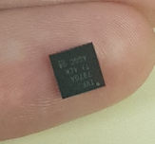
Smart Doorlock
16. Results
Cost issues & PCB production limitation
Development boards will be mounted to chassis
Notes:
https://www.youtube.com/watch?feature=player_detailpage&v=Cytk-GvEdA8#t=59

Slide 24
Smart Doorlock
16. Results
Both NFC & IoT operation works as intended
Requirements have been mostly met
Battery backup system – cost & size issue
Notes:
https://www.youtube.com/watch?feature=player_detailpage&v=Cytk-GvEdA8#t=59

Slide 25
Smart Doorlock
Q & A?
Notes:
https://www.youtube.com/watch?feature=player_detailpage&v=Cytk-GvEdA8#t=59

